Slide 1
Will It Rain In Seattle?
Isabella Sturm
DSC 630

Slide 2
Data Set – Rain in Seattle
Number Rows: 25,551
Date Range: 1948-01-01 to 2017-12-14
Columns in Dataset:
DATE: Date (yyyy-mm-dd)
PRCP: Precipitation (inches),
TMAX: Max Temperature (F)
TMIN: Min Temperature (F)
RAIN: T/F Rain in Seattle

Slide 3
Data Preparation
Removed Missing Data (only 3 rows in initial dataset)
No outliers
Created new columns (features) from DATE
DAY: Sunday-Saturday (1-7)
DAY_OF_MONTH (1-30, 1-31, 1-28/29)
DAY_OF_YEAR: 1-365 (or 366 on Leap Years)
WEEK: 1-52

Slide 4
Exploratory Results
Minimum vs Maximum Temperatures: Rain vs No Rain
Roughly evenly distributed, slightly skewed left
Could be useful predictor of rain

Slide 5
Exploratory Results
Day of Month: Rain vs No Rain
No apparent pattern that day of month can be used to predict if it will rain

Slide 6
Exploratory Results
Day of Year & Week of Year: Rain vs No Rain
Nearly inverses of each other, indicating it is probably a good predictor of rain.

Slide 7
Exploratory Results
Month: Rain vs No Rain
Nearly inverses of each other, indicating it is probably a good predictor of rain.

Slide 8
Exploratory Results
Day of Week: Rain vs No Rain
Similar counts for days of the week between days with rain vs no rain
Not clear indicator or predictor of rain

Slide 9
Models: Classification
Logistic Regression
K-Nearest Neighbors
Decision Tree
Random Forest

Slide 10
Features
Independent Variables
Minimum Temperature (TMIN)
Maximum Temperature (TMAX)
Day of the Week (DAY)
Week in the Year (WEEK)
Month (MONTH)
Day of the Month (DAY_OF_MONTH)
Day of the Year (DAY_OF_YEAR)
Dependent Variable
Whether or not it rained (RAIN)

Slide 11
Initial Modelling Results

Slide 12
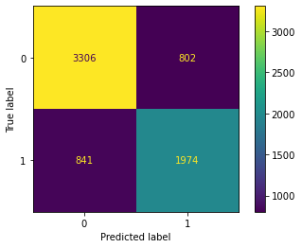
Prediction Models
K-Nearest Neighbors
Accuracy: 76.26%

Slide 13
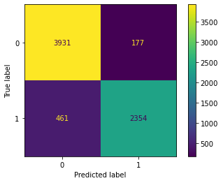
Prediction Models
Logistic Regression
Accuracy: 90.78%

Slide 14
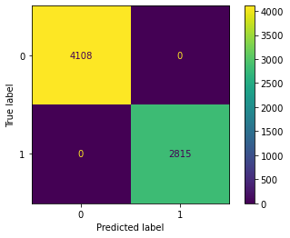
Prediction Models
Decision Tree
Accuracy: 100.00%

Slide 15
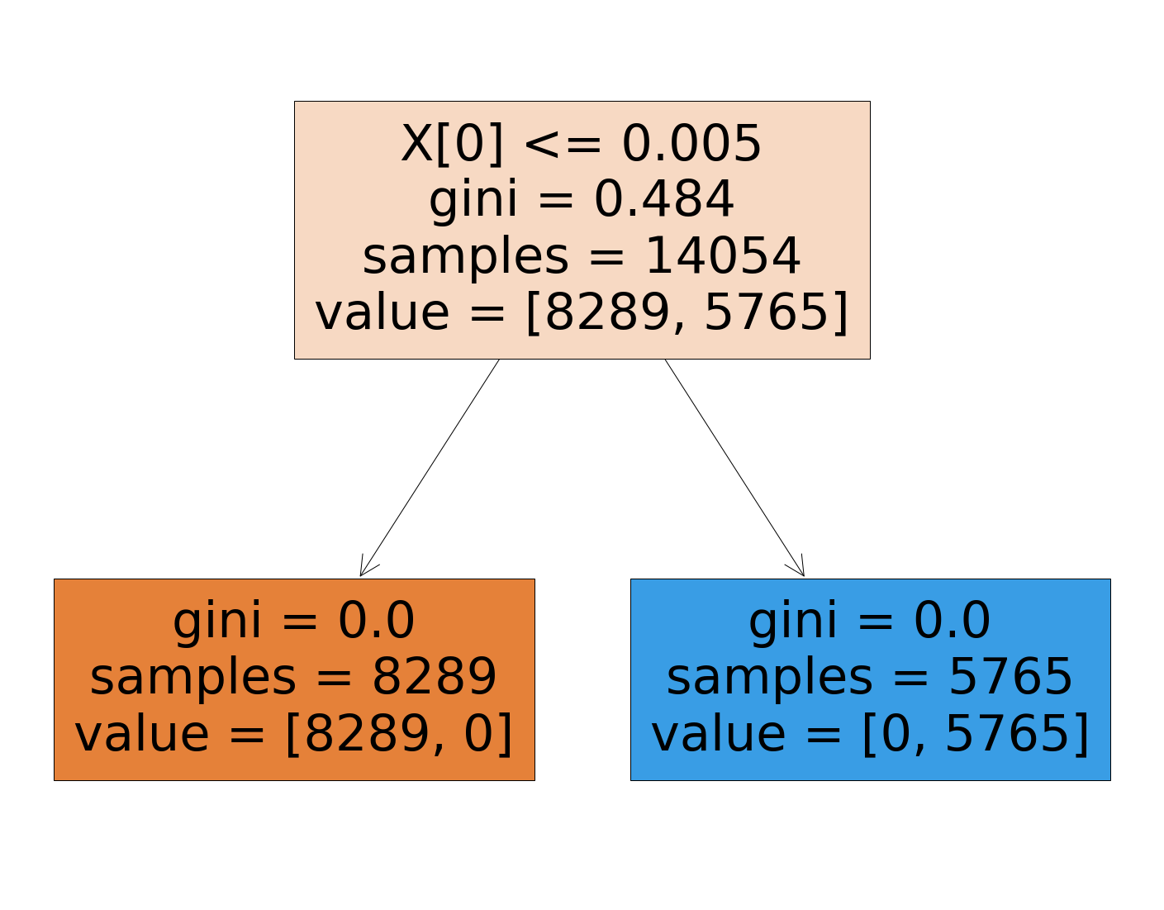
Overcoming Overfitting
Removed Precipitation (PRCP) variable
Notes:
Initially included PRCP but that basically equates to the RAIN variable causing overfitting

Slide 16
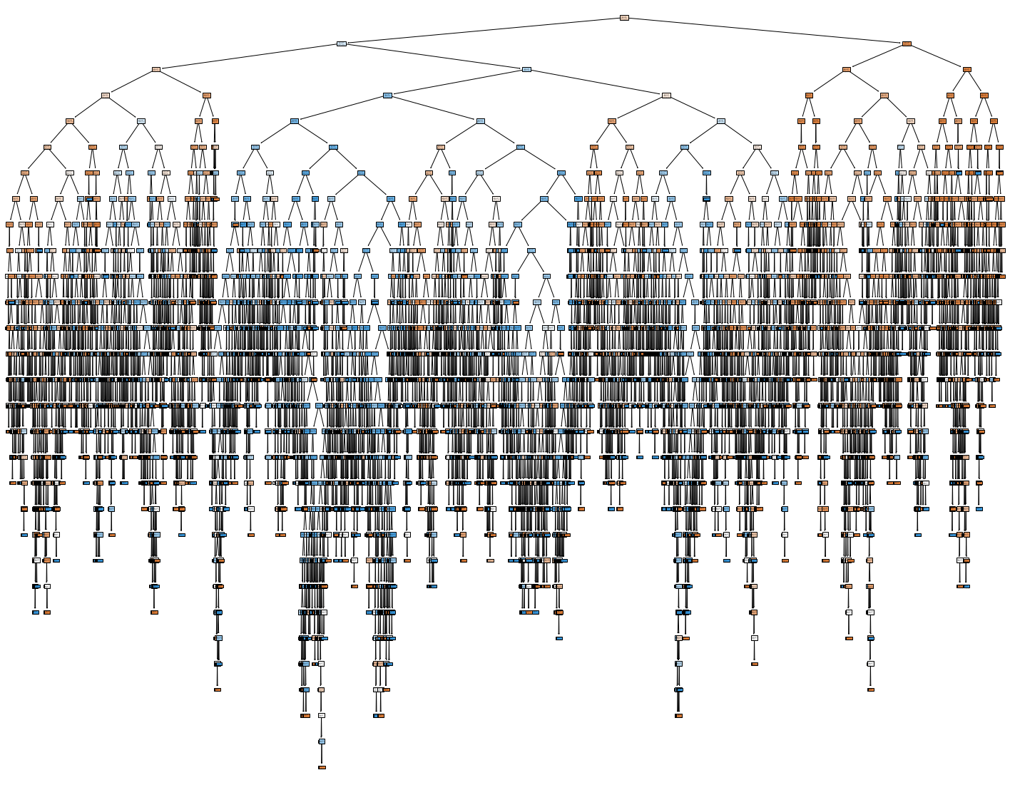
Notes:
Decision Tree without PRCP

Slide 17
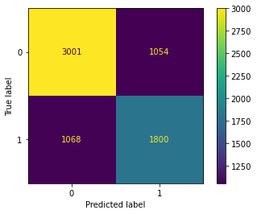
Prediction Models
Decision Tree
Accuracy: 69.35%

Slide 18
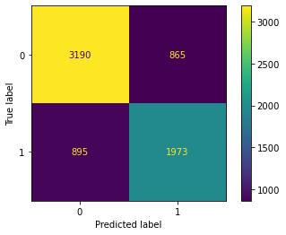
Prediction Models
K-Nearest Neighbors
Accuracy: 74.58%

Slide 19

Prediction Models
Random Forest
Accuracy: 75.65%

Slide 20

Prediction Models
Logistic Regression
Accuracy: 76.35%

Slide 21
Challenges
Data: Methods for calculated values such as Day of Week, Month, Day of Month, Day of Year and Week of Year resulted in more rows with missing data
Ended up removing missing data but drastically reduced data size
Limited variables for analysis
Next steps would be to pull more weather-related data such as humidity to see how predictions would change
During modeling, I had a model with 100% accuracy which could have been due to overfitting
After further analysis, I realized one of the features (PRCP) was a numeric version of the target RAIN so it needed to be removed

Slide 22
Conclusion
Happy with 76% accuracy but feel this could be improved
Improvements for a future version:
Connect to Weather API to pull additional weather information – more/better features could improve accuracy
Using API could also be a way to get more real-time data (deployment of model)
Research more models and test to if there are better models to use
So many models it would be difficult to really learn them all and know if I found the best one

Slide 23
Future Plans for Analysis
Currently have great results for analysis/predictions but could improve for fuller data picture
Pull more weather data variables to get a fuller picture of weather data predictions
Fix missing values from calculated fields to retain more data points for analysis
Retrain models with additional data

Slide 24
Putting it to the Test
November 17
RAIN = False
November 19
RAIN = False

Slide 25

Thank You!

